Slide 1
Karnaugh Maps (K-Maps)
A visual way to simplify logic expressions
It gives the most simplified form of the expression

Slide 2
Introduction
Simplification of Boolean functions leads to simpler (and usually faster) digital circuits.
Simplifying Boolean functions using identities is time-consuming and error-prone.
This special section presents an easy, systematic method for reducing Boolean expressions.

Slide 3
Introduction
In 1953, Maurice Karnaugh was a telecommunications engineer at Bell Labs.
While exploring the new field of digital logic and its application to the design of telephone circuits, he invented a graphical way of visualizing and then simplifying Boolean expressions.
This graphical representation, now known as a Karnaugh map, or Kmap, is named in his honor.

Slide 4
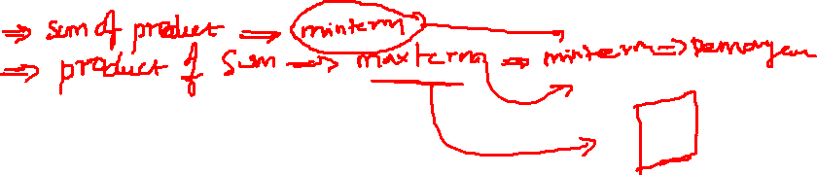
Description of Kmaps and Terminology
A Kmap is a matrix consisting of rows and columns that represent the output values of a Boolean function.
The output values placed in each cell are derived from the minterms of a Boolean function.
A minterm is a product term that contains all of the function’s variables exactly once, either complemented or not complemented.

Slide 5
Rules to obtain the most simplified expression
Simplification of logic expression using Boolean algebra is awkward because:
  it lacks specific rules to predict the most suitable next step in the simplification process
  it is difficult to determine whether the simplest form has been achieved.
A Karnaugh map is a graphical method used to obtained the most simplified form of an expression in a standard form (Sum-of-Products or Product-of-Sums).
The simplest form of an expression is the one that has the minimum number of terms with the least number of literals (variables) in each term.
By simplifying an expression to the one that uses the minimum number of terms, we ensure that the function will be implemented with the minimum number of gates.
By simplifying an expression to the one that uses the least number of literals for each terms, we ensure that the function will be implemented with gates that have the minimum number of inputs.

Slide 6


Slide 7
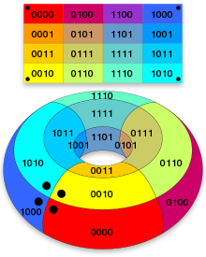

Slide 8
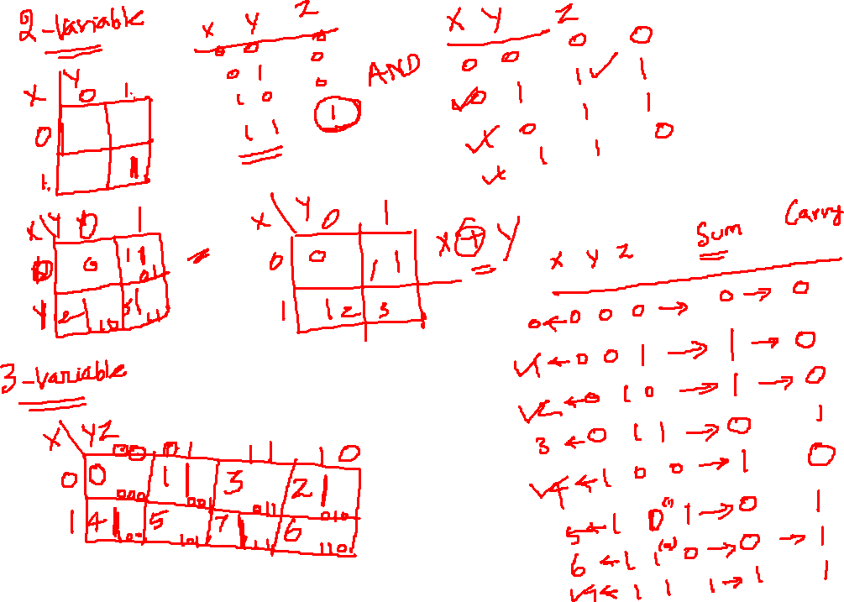


Slide 9
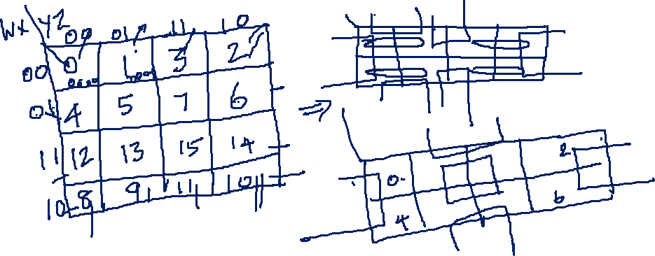

Slide 10
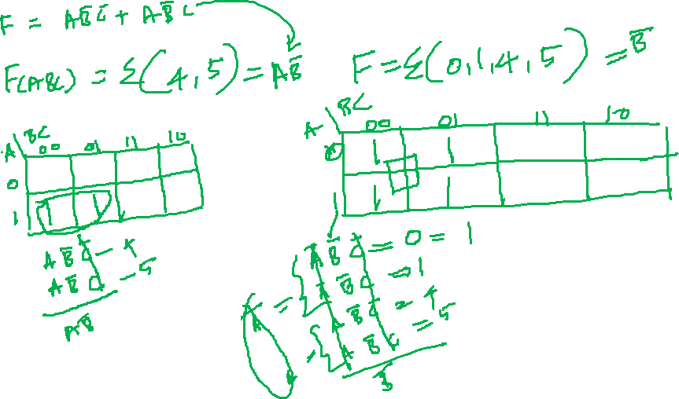

Slide 11
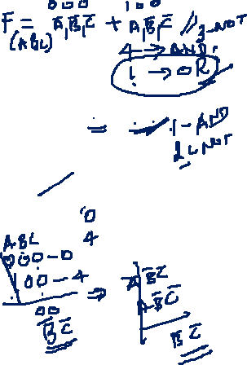
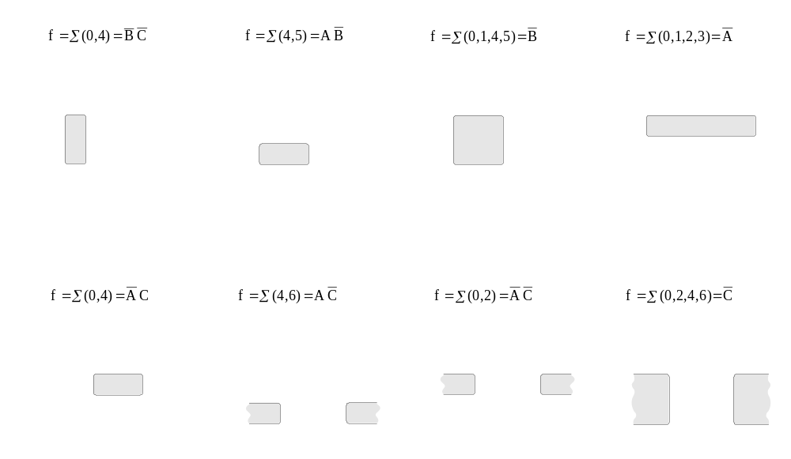
Three-Variable K-Maps

Slide 12
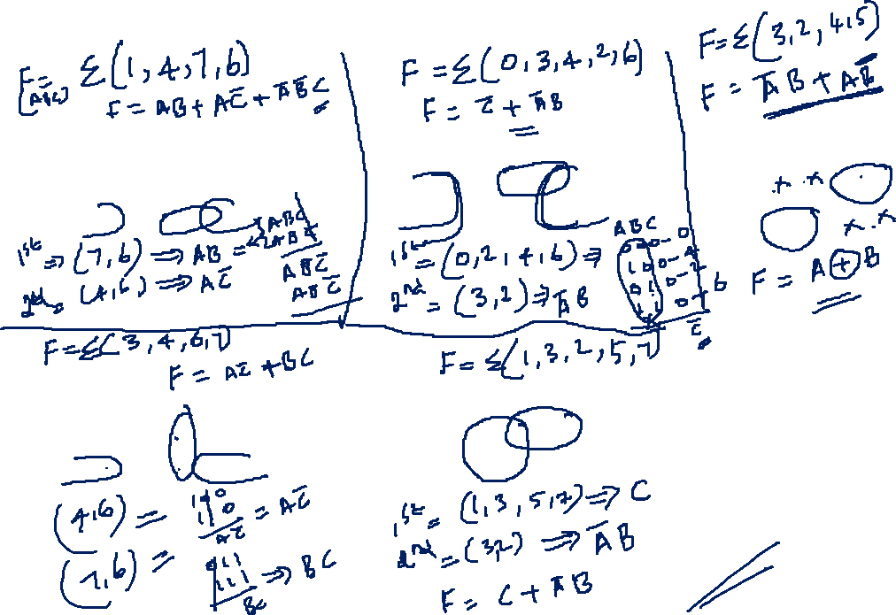
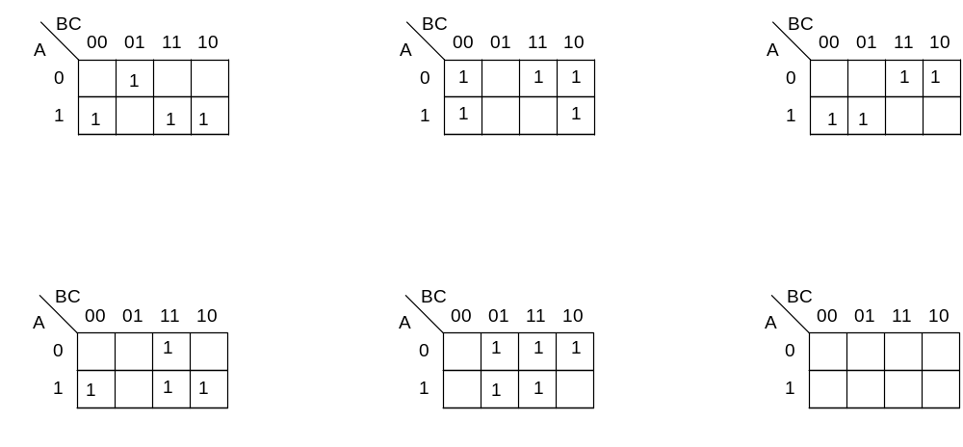
Three-Variable K-Map Examples

Slide 13
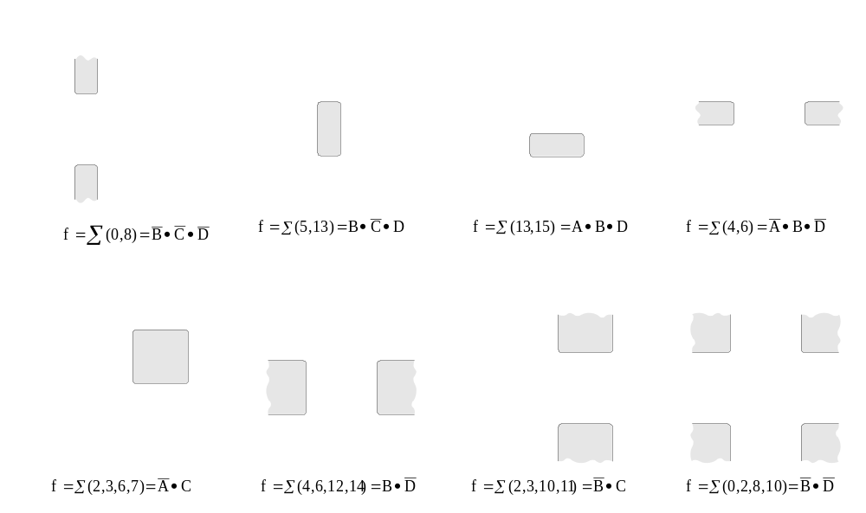
Four-Variable K-Maps

Slide 14
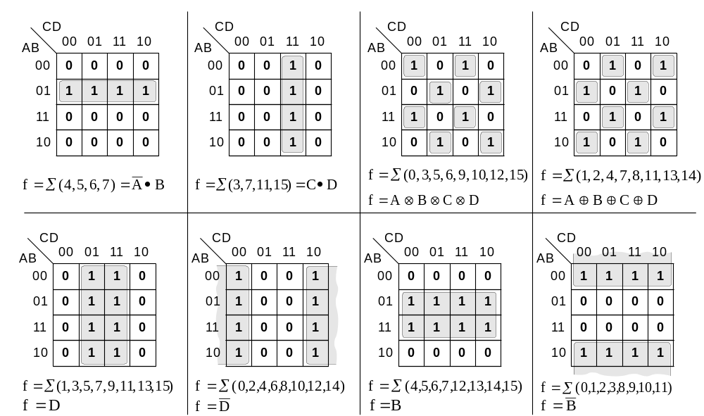

Four-Variable K-Maps

Slide 15
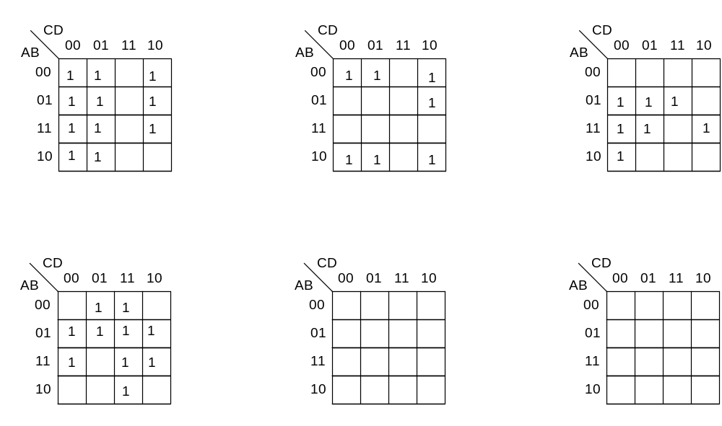
Four-Variable K-Maps Examples

Slide 16
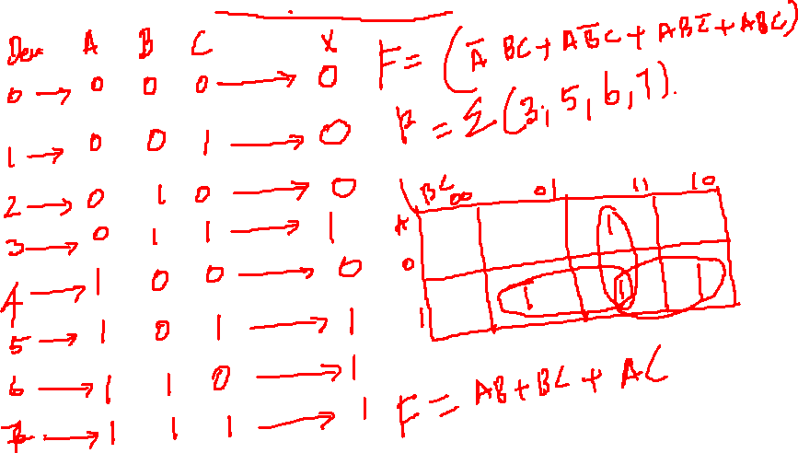
Four-Variable K-Maps Examples
Example: Design a 3-input (A,B,C) digital circuit that will give at its output (X) a logic 1 only if the binary number formed at the input has more ones than zeros

Slide 17
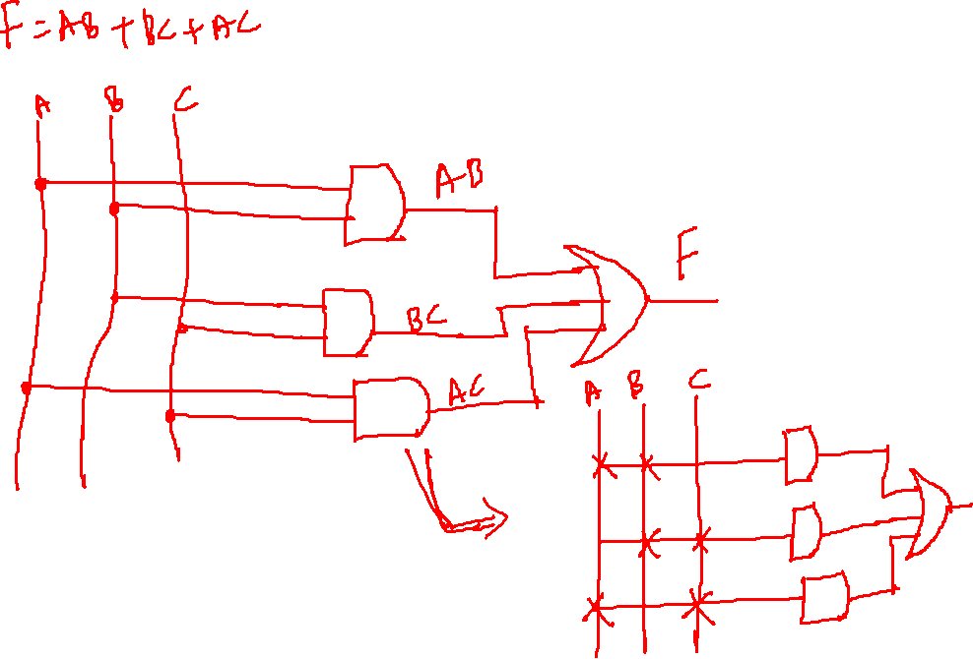

Slide 18
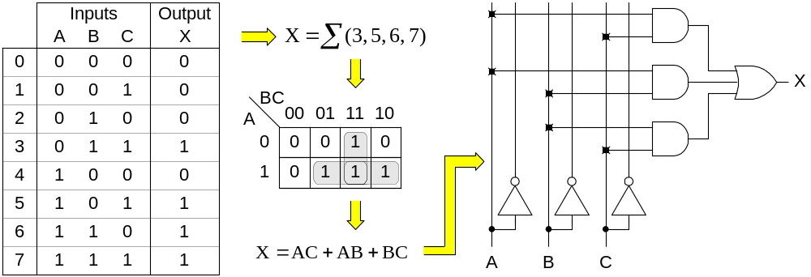
Design of combinational digital circuits
Steps to design a combinational digital circuit:
  From the problem statement derive the truth table
  From the truth table derive the unsimplified logic expression
  Simplify the logic expression
  From the simplified expression draw the logic circuit
Example: Design a 3-input (A,B,C) digital circuit that will give at its output (X) a logic 1 only if the binary number formed at the input has more ones than zeros.

Slide 19
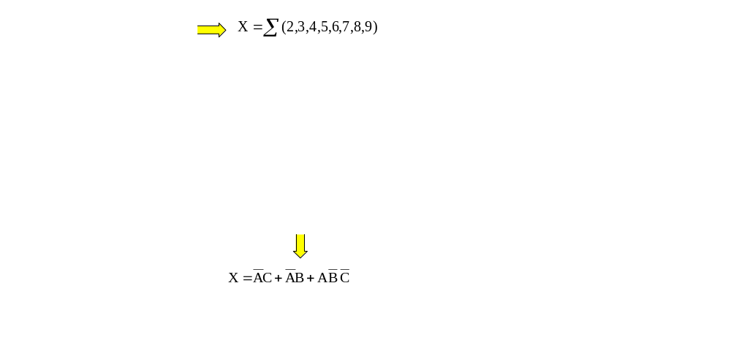
Design of combinational digital circuits (Cont.)
Example: Design a 4-input (A,B,C,D) digital circuit that will give at its output (X) a logic 1 only if the binary number formed at the input is between 2 and 9 (including).

Slide 20
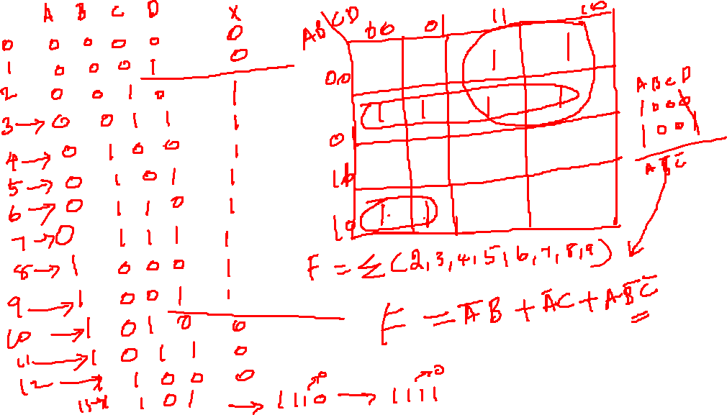
Example: Design a 4-input (A,B,C,D) digital circuit that will give at its output (X) a logic 1 only if the binary number formed at the input is between 2 and 9 (including).

Slide 21
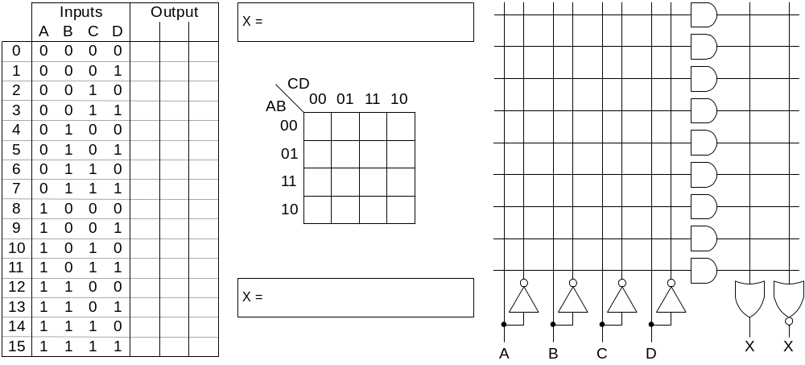
Design of combinational digital circuits (Example)
Example: Design a 4-input (A,B,C,D) digital circuit that will give at its output (X) a logic 1 only if there more ones than zeros in the binary number formed at the input.

Slide 22
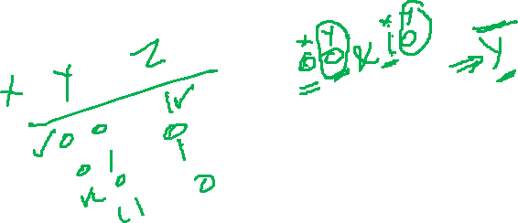
Don’t Care Conditions
Real circuits don’t always need to have an output defined for every possible input.
  For example, some calculator displays consist of 7-segment LEDs. These LEDs can display 2 ⁷ -1 patterns, but only ten of them are useful.
If a circuit is designed so that a particular set of inputs can never happen, we call this set of inputs a don’t care condition.
They are very helpful to us in Kmap circuit simplification.

Slide 23
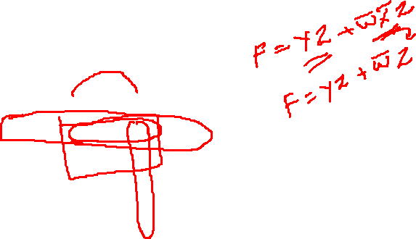
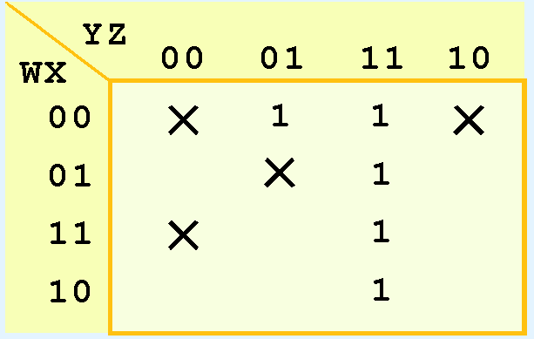
Don’t Care Conditions
In a Kmap, a don’t care condition is identified by an X in the cell of the minterm(s) for the don’t care inputs, as shown below.
In performing the simplification, we are free to include or ignore the X’s when creating our groups.

Slide 24

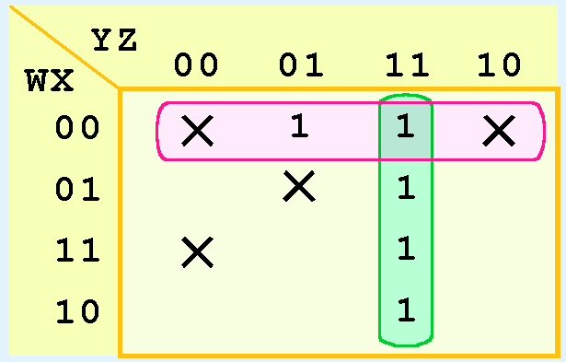
Don’t Care Conditions
In one grouping in the Kmap below, we have the function:

Slide 25

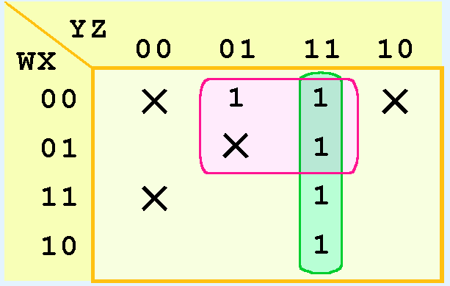
Don’t Care Conditions
A different grouping gives us the function:

Slide 26
Don’t Care Conditions
The truth table of:
differs from the truth table of:
However, the values for which they differ, are the inputs for which we have don’t care conditions.

Slide 27
Recapping the rules of Kmap simplification:
  Groupings can contain only 1s; no 0s.
  Groups can be formed only at right angles; diagonal groups are not allowed.
  The number of 1s in a group must be a power of 2 – even if it contains a single 1.
  The groups must be made as large as possible.
  Groups can overlap and wrap around the sides of the Kmap.
  Use don’t care conditions when you can.

Slide 28
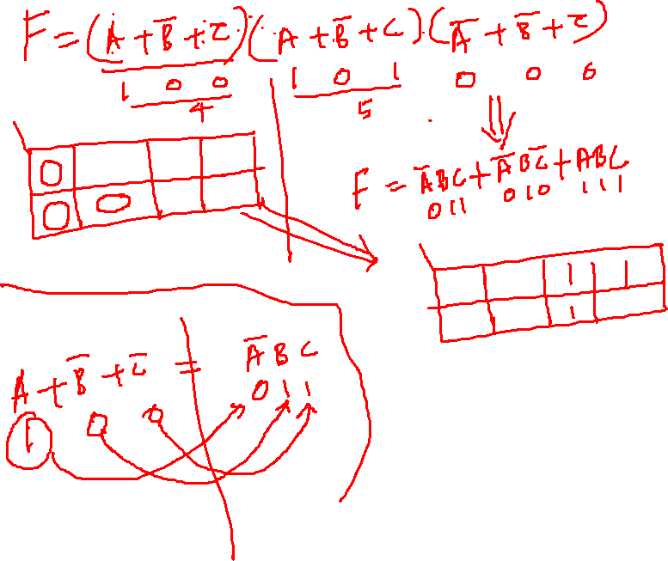

Slide 29
Overview
Binary decoders
  Converts an n-bit code to a single active output
  Can be developed using AND/OR gates
  Can be used to implement logic circuits.
Binary encoders
  Converts one of 2^{n} inputs to an n-bit output
  Useful for compressing data
  Can be developed using AND/OR gates
Both encoders and decoders are extensively used in digital systems
Notes:
credential:
bring a computer
die photo
wafer
:
This can be an hidden slide. I just want to use this to do my own planning.
I have rearranged Culler’s lecture slides slightly and add more slides. This covers everything he covers in his first lecture (and more) but may
We will save the fun part, “ Levels of Organization,” at the end (so student can stay awake): I will show the internal stricture of the SS10/20.
Notes to Patterson: You may want to edit the slides in your section or add extra slides to taylor your needs.

Slide 30
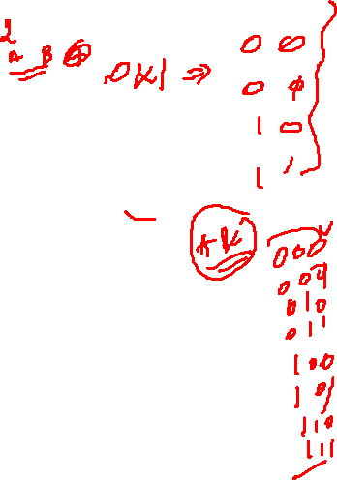
Binary Decoder
Black box with n input lines and 2^{n} output lines
Only one output is a 1 for any given input
Binary
Decoder
n
inputs
2^{n} outputs

Slide 31
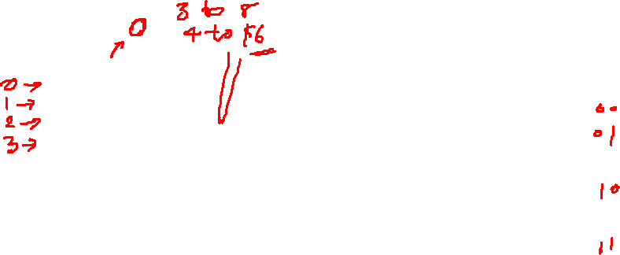
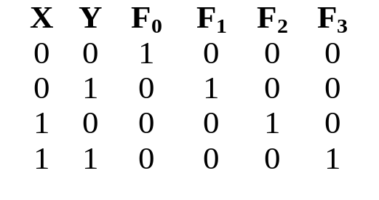
2-to-4 Binary Decoder
Truth Table:
F₀ = X'Y'
F₁ = X'Y
From truth table, circuit for 2x4 decoder is:
Note: Each output is a 2-variable minterm (X'Y', X'Y, XY' or XY)
F₂ = XY'
F₃ = XY
F0
F1
F2
F3
X
Y
X
2-to-4
Decoder
Y

Slide 32
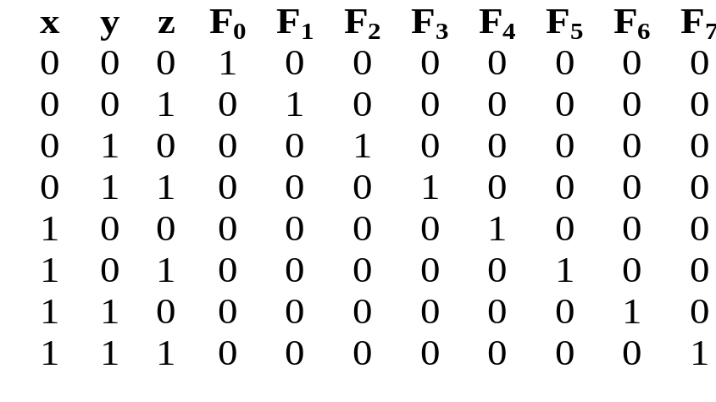
3-to-8 Binary Decoder
Truth Table:
F₀ = x'y'z'
F₁ = x'y'z
F₂ = x'yz'
F₃ = x'yz
F₄ = xy'z'
F₅ = xy'z
F₆ = xyz'
F0
F1
F2
F3
F4
F5
F6
F7
F₇ = xyz
X
3-to-8
Decoder
Y
Z
x
y
z

Slide 33
Implementing Functions Using Decoders
Any n-variable logic function can be implemented using a single n-to-2^{n} decoder to generate the minterms
  OR gate forms the sum.
  The output lines of the decoder corresponding to the minterms of the function are used as inputs to the or gate.
Any combinational circuit with n inputs and m outputs can be implemented with an n-to-2^{n} decoder with m OR gates.
Suitable when a circuit has many outputs, and each output function is expressed with few minterms.

Slide 34
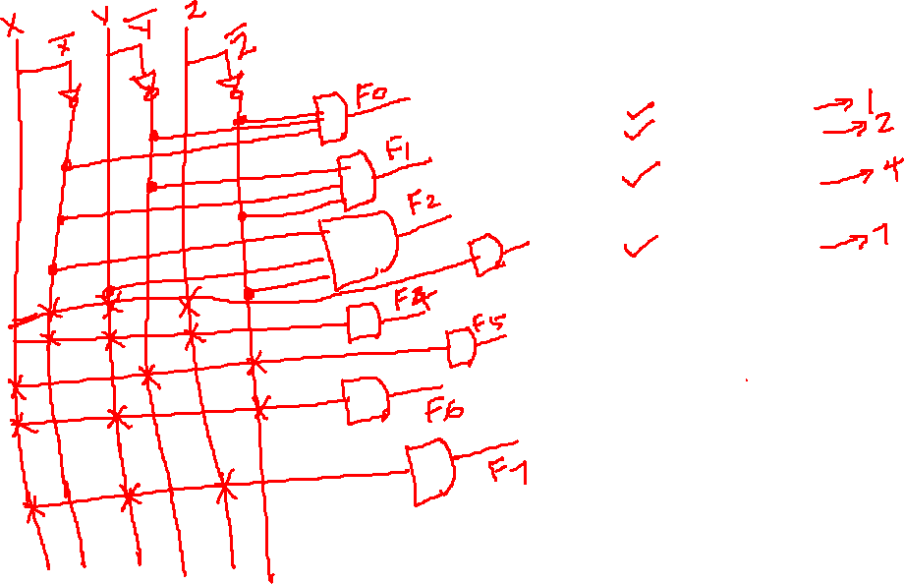
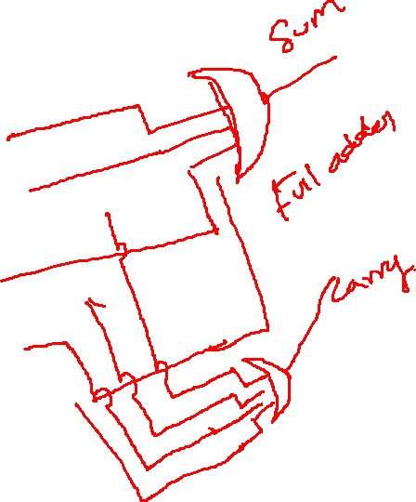
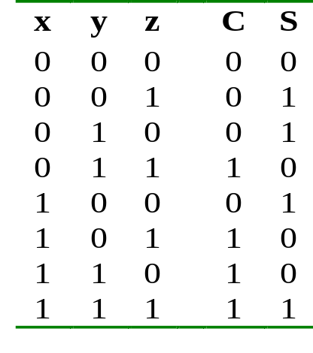

Slide 35
Implementing Functions Using Decoders
Example: Full adder
  S(x, y, z) = Σ (1,2,4,7)
  C(x, y, z) = Σ (3,5,6,7)
3-to-8
Decoder
0
1
2
3
4
5
6
7
S
x
S₂
S₁
S₀
y
z
C

Slide 36
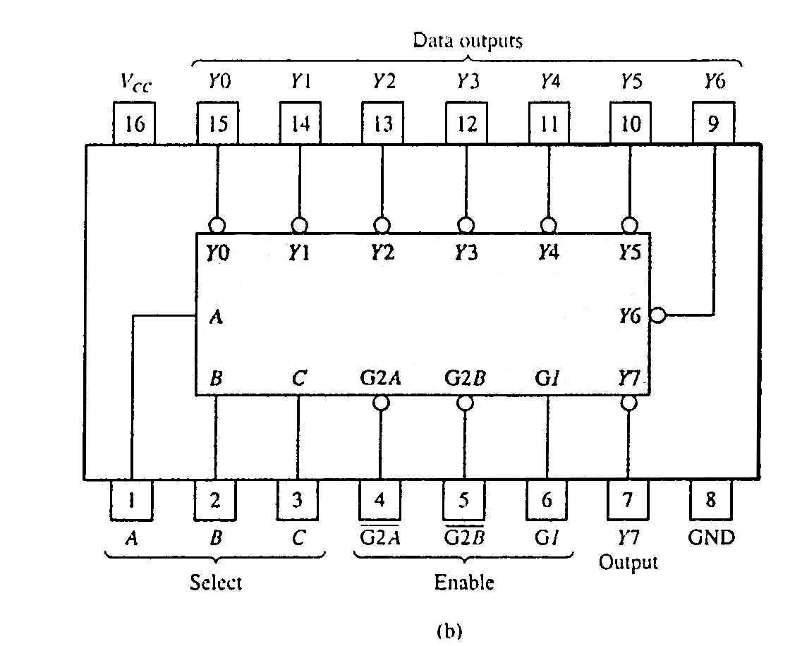
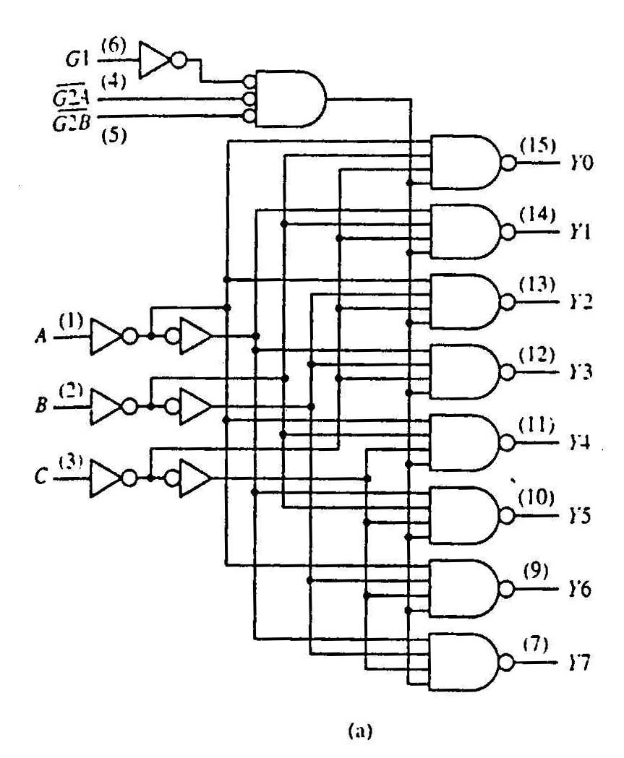
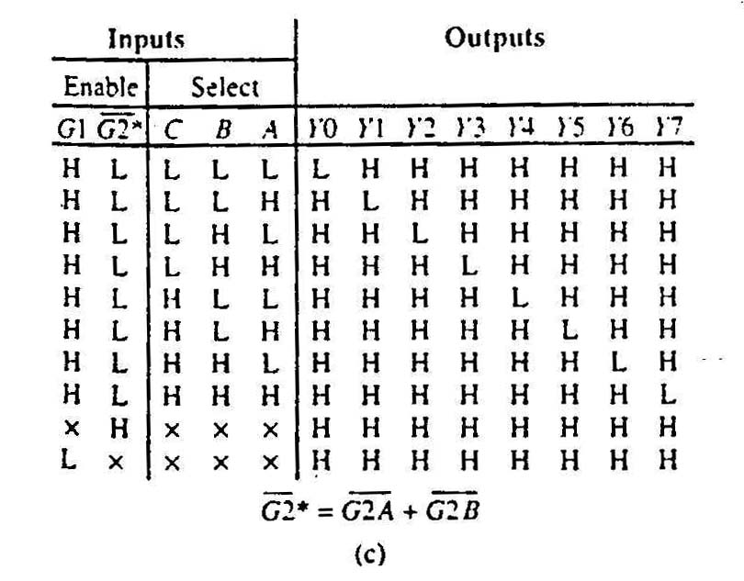
Standard MSI Binary Decoders Example
74138 (3-to-8 decoder)
(a) Logic circuit.
(b) Package pin configuration.
(c) Function table.

Slide 37
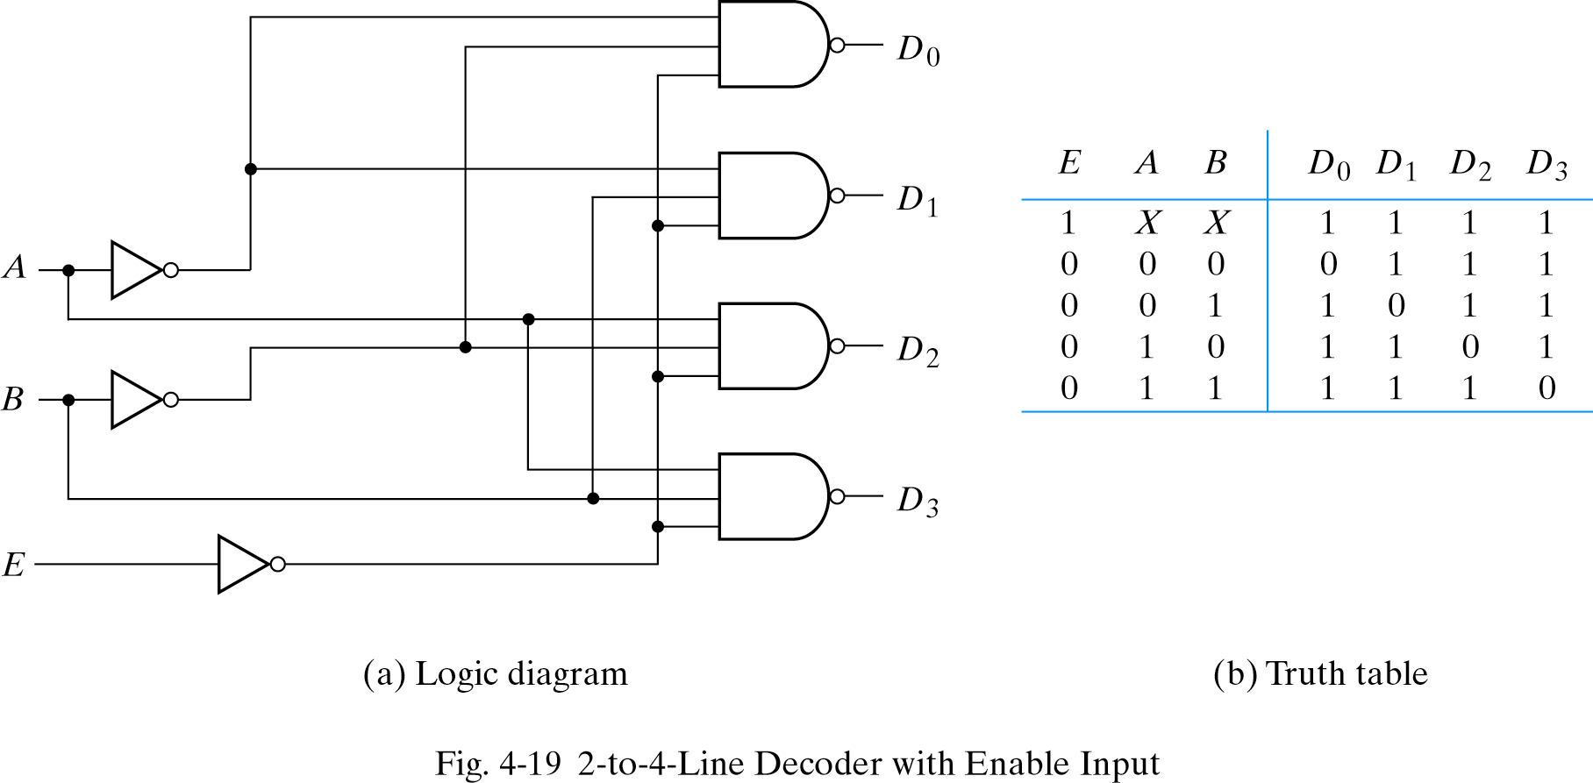
Building a Binary Decoder with NAND Gates
Start with a 2-bit decoder
  Add an enable signal (E)
Note: use of NANDs
only one 0 active!
if E = 0

Slide 38
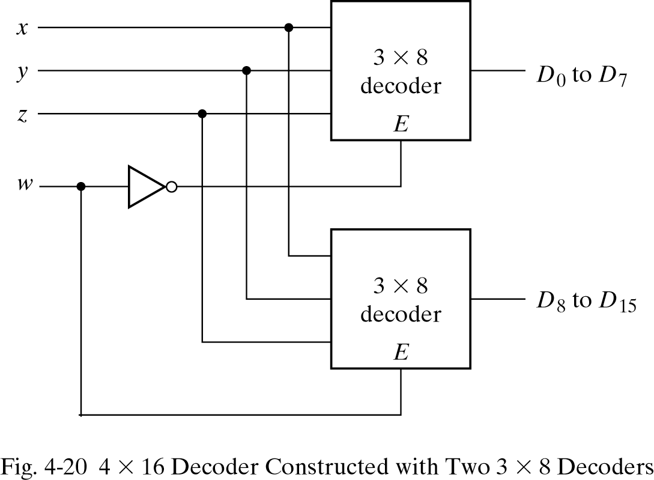
Use two 3 to 8 decoders to make 4 to 16 decoder
Enable can also be active high
In this example, only one decoder can be active at a time.
x, y, z effectively select output line for w

Slide 39
Encoders
If the a decoder's output code has fewer bits than the input code, the device is usually called an encoder.
e.g. 2^{n}-to-n
The simplest encoder is a 2^{n}-to-n binary encoder
  One of 2^{n} inputs = 1
  Output is an n-bit binary number
Binary
encoder
2^{n}
inputs
n
outputs
.
.
.
.
.
.

Slide 40
8-to-3 Binary Encoder
At any one time, only
one input line has a value of 1.
Inputs
Outputs
I
0
I
1
I
2
I
3
I
4
I
5
I
6
I
7
y₂
y₁
y₀
1
0
0
0
0
0
0
0
0
0
0
0
1
0
0
0
0
0
0
0
0
1
0
0
1
0
0
0
0
0
0
1
0
0
0
0
1
0
0
0
0
0
1
1
0
0
0
0
1
0
0
0
1
0
0
0
0
0
0
0
1
0
0
1
0
1
0
0
0
0
0
0
1
0
1
1
0
0
0
0
0
0
0
0
1
1
1
1
I₀
I₁
I₂
I₃
I₄
I₅
I₆
I₇
y₂ = I₄ + I₅ + I₆ + I₇
y₁ = I₂ + I₃ + I₆ + I₇
y₀ = I₁ + I₃ + I₅ + I₇

Slide 41
8-to-3 Priority Encoder
What if more than one input line has a value of 1?
Ignore “lower priority” inputs.
Idle indicates that no input is a 1.
Note that polarity of Idle is opposite from Table 4-8 in Mano
Inputs
Outputs
I
0
I
1
I
2
I
3
I
4
I
5
I
6
I
7
y₂
y₁
y₀ Idle
0
0
0
0
0
0
0
0
x
x
x 1
1
0
0
0
0
0
0
0
0
0
0 0
X
1
0
0
0
0
0
0
0
0
1 0
X
X
1
0
0
0
0
0
0
1
0 0
X
X
X
1
0
0
0
0
0
1
1 0
X
X
X
X
1
0
0
0
1
0
0 0
X
X
X
X
X
1
0
0
1
0
1 0
X
X
X
X
X
X
1
0
1
1
0 0
X
X
X
X
X
X
X
1
1
1
1 0

Slide 42
Priority Encoder (8 to 3 encoder)
Assign priorities to the inputs
When more than one input are asserted, the output generates the code of the input with the highest priority
Priority Encoder :
H7=I7 (Highest Priority)
H6=I6.I7’
H5=I5.I6’.I7’
H4=I4.I5’.I6’.I7’
H3=I3.I4’.I5’.I6’.I7’
H2=I2.I3’.I4’.I5’.I6’.I7’
H1=I1. I2’.I3’.I4’.I5’.I6’.I7’
H0=I0.I1’. I2’.I3’.I4’.I5’.I6’.I7’
IDLE= I0’.I1’. I2’.I3’.I4’.I5’.I6’.I7’
Encoder
Y0 = I1 + I3 + I5 + I7
Y1 = I2 + I3 + I6 + I7
Y2 = I4 + I5 + I6 + I7
Priority encoder
Priority Circuit
Binary encoder
I0
I0
H0
I0
I1
I1
H1
I1
I2
I2
H2
I2
Y0
Y0
I3
I3
H3
I3
Y1
Y1
I4
I4
H4
I4
Y2
Y2
I5
I5
H5
I5
I6
I6
H6
I6
I7
I7
H7
I7
IDLE
IDLE

Slide 43
Encoder Application (Monitoring Unit)
Encoder identifies the requester and encodes the value
Controller accepts digital inputs.
Alarm Signal
Contoller Response
Machine 1
Machine 2
Machine
Code
Action
Encoder
Controller
Machine n

Slide 44
Decoder allows for generation of a single binary output from an input binary code
  For an n-input binary decoder there are 2^{n} outputs
Decoders are widely used in storage devices (e.g. memories)
  We will discuss these in a few weeks
Encoders all for data compression
Priority encoders rank inputs and encode the highest priority input
Notes:
credential:
bring a computer
die photo
wafer
:
This can be an hidden slide. I just want to use this to do my own planning.
I have rearranged Culler’s lecture slides slightly and add more slides. This covers everything he covers in his first lecture (and more) but may
We will save the fun part, “ Levels of Organization,” at the end (so student can stay awake): I will show the internal stricture of the SS10/20.
Notes to Patterson: You may want to edit the slides in your section or add extra slides to taylor your needs.

